Slide 1
University of Diyala / College of Engineering Department of Chemical Engineering Windows 7
Preparing Lect. Omar A. Imran

Slide 2
the Third lecturer
Parts of the window :
Although the contents of each window differ from one window to another , but that all windows share some things in general . It is of these things in common , windows always appear on the desktop - which represents the main working area of the screen . In addition , majority of the windows contain the same basic parts .

Slide 3
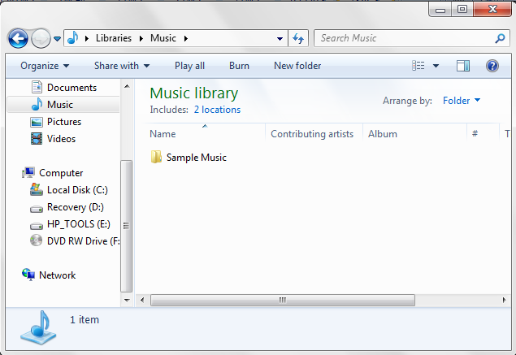

Slide 4
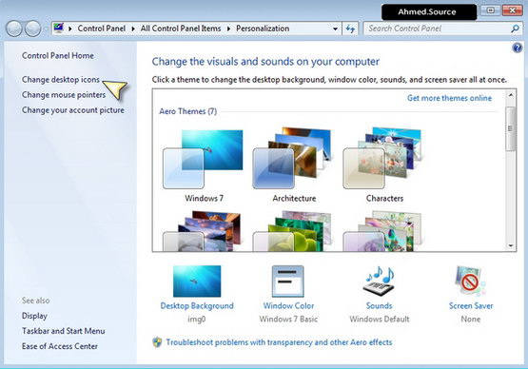
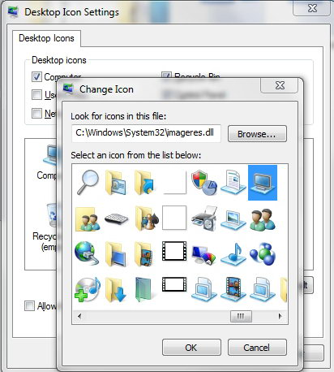
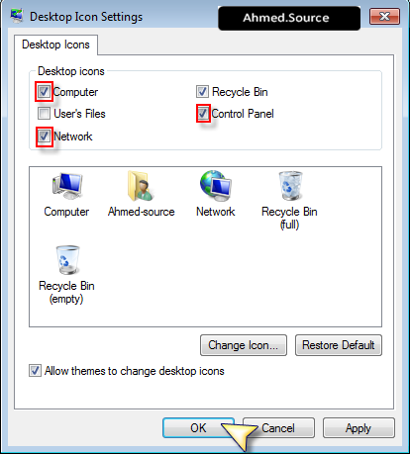
Change desktop icons
To change the desktop icons to click on the right-wing empty area in the Desktop and choose customize it as the picture to show the following window
We choose them it change desktop icons - change the desktop icons to appear the following window

Slide 5
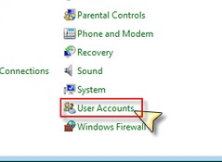
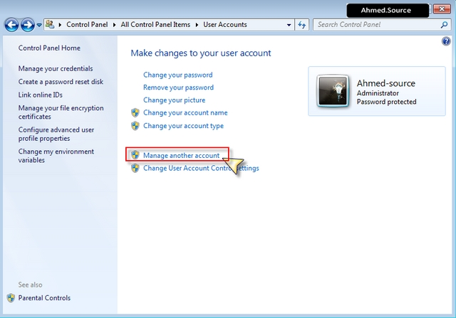
Create a new user account
To create a new user account, open the Control Panel and choose up user accounts
To show us a window user accounts and choose which is Manage another account as in Fig.

Slide 6
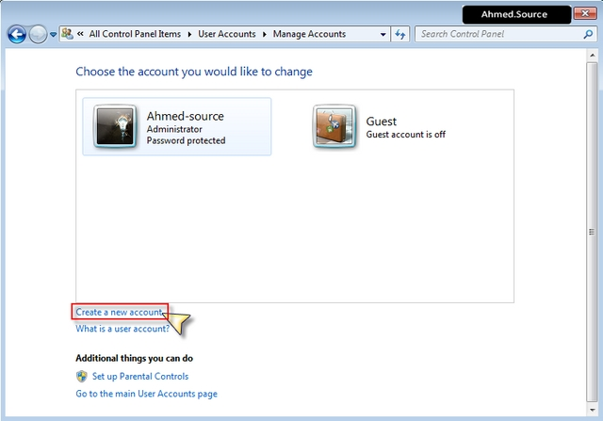
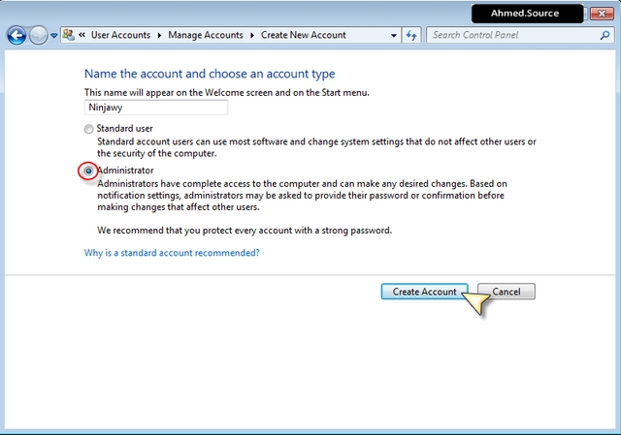
To show us the next window that displays all our existing accounts currently on the system
The ones we choose it Create a new account to show up the following window

Slide 7
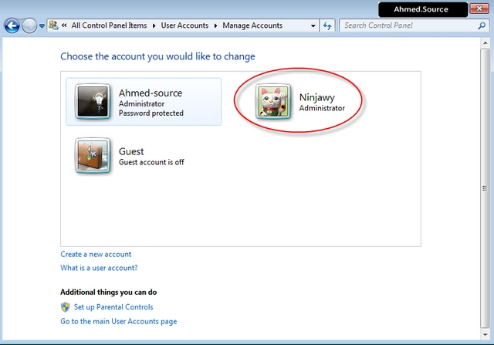
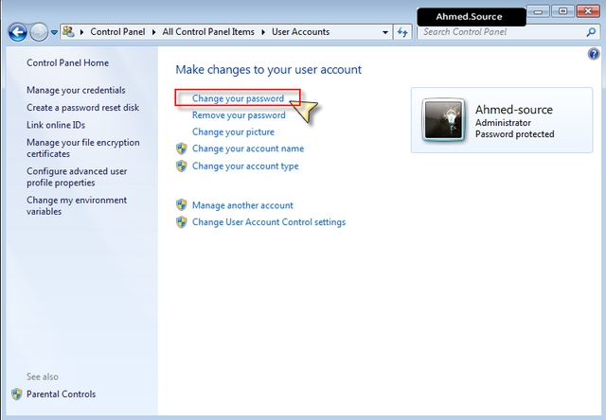
Where we write the name of the account you want created and then define the powers and better to be administrator Then push button Create account
Modify or cancel your password

Slide 8
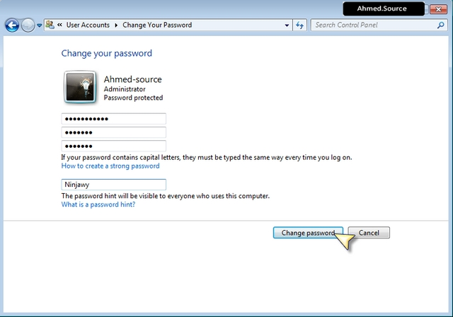
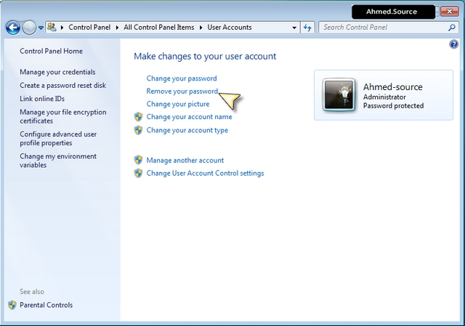
And we choose them up Change your password to show us the following
window

Slide 9
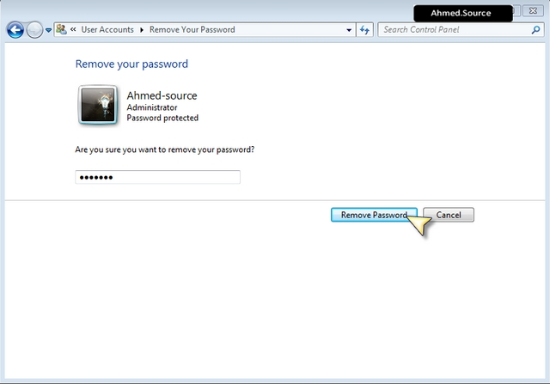
We choose to remove the password - Remove your password to show us a window confirm the deletion as the picture

